Slide 1


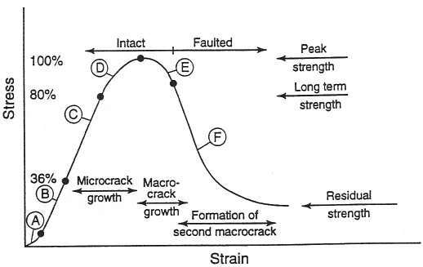
Title of Paper (B Times New Roman bold black font size pt 60 pt)
Paper Code:
IGEC-...
First Author^{, 1}*, Second Author², …
First Author’s Affiliation, University | Work place.
Second Author’s Affiliation, University | Work place, Email Address.
* Corresponding Author’ Email Address (Times New Roman Font, size 28 pt)
Introduction
Results
In this template, the method of preparing the poster of The First National Conference on Infrastructure and Geotechnical Engineering Conference is explained. The template is prepared based on some features available in Microsoft-PowerPoint software. An important point that needs to be taken into consideration for preparing a ready-to-print version is that the styles required for all parts of the poster are defined in the template and authors can use them to quickly adapt their paper file to the desired method.
Some points should be taken into consideration, including:
All the presenters of the article in the form of a poster are requested to prepare their poster in the format of the proposed framework and refrain from presenting the poster in unusual frameworks.
The poster should be written in English and carefully corrected for spelling and grammar.
Use black color for typing. (Do not use italics or underlined fonts)
Use sections with headers.
The sections that cover the main columns of the poster usually include:
1 – Introduction
2 – Methods
3 – Results
4 – Conclusions
5 – References and acknowledgments
The Poster Size: 100*70 cm
Please present the key findings of your research in a visually appealing way in the results section.
Use graphs and tables with captions.
You need to carefully select only the very essential graphs and tables. Please do not use many graphs and tables in your poster.
Figure 1. Typical stress - strain diagram for cold press test on rock sample
Table 1. Fonts’ size and type
Size | Font | Position
32 | Times New Roman | main body text
24 | Times New Roman | tables and figure captions
24 | Times New Roman | text in tables
20 | Times New Roman | text in figures
24 | Times New Roman | references
Conclusion
Methods
Summarize your research and discuss and interpret it in the section. Also, comment for further research.
Explain the specific procedures or techniques of your research in the methods section.
References
[1] Flanigan, O.; (1995); “Underground Gas Storage Facilities: Design and Implementation”, Elsevier.
[2] Roth, K., & Brodrick, J.; (2009); “Seasonal Energy Storage”, ASHRAE Journal, 51(1), 41-44.
[3] Blöcher, G., Kluge, C., Goense, T., Pei, L., Bakker, R. R., & Bruhn, D.; (2019); “Hydraulic-mechanical characterization of geothermal reservoir rocks”, In European geothermal congress.
[4] www.scribbr.com/category/citing-sources/. Accessed 28 Feb 2024.
[5]How to Design an Award-Winning Scientific Conference Poster, accessed 2024/05/29, https://www.animateyour.science/post/how-to-design-an-award-winning-conference-poster
The First National Conference on Infrastructure and Geotechnical Engineering

